Slide 1
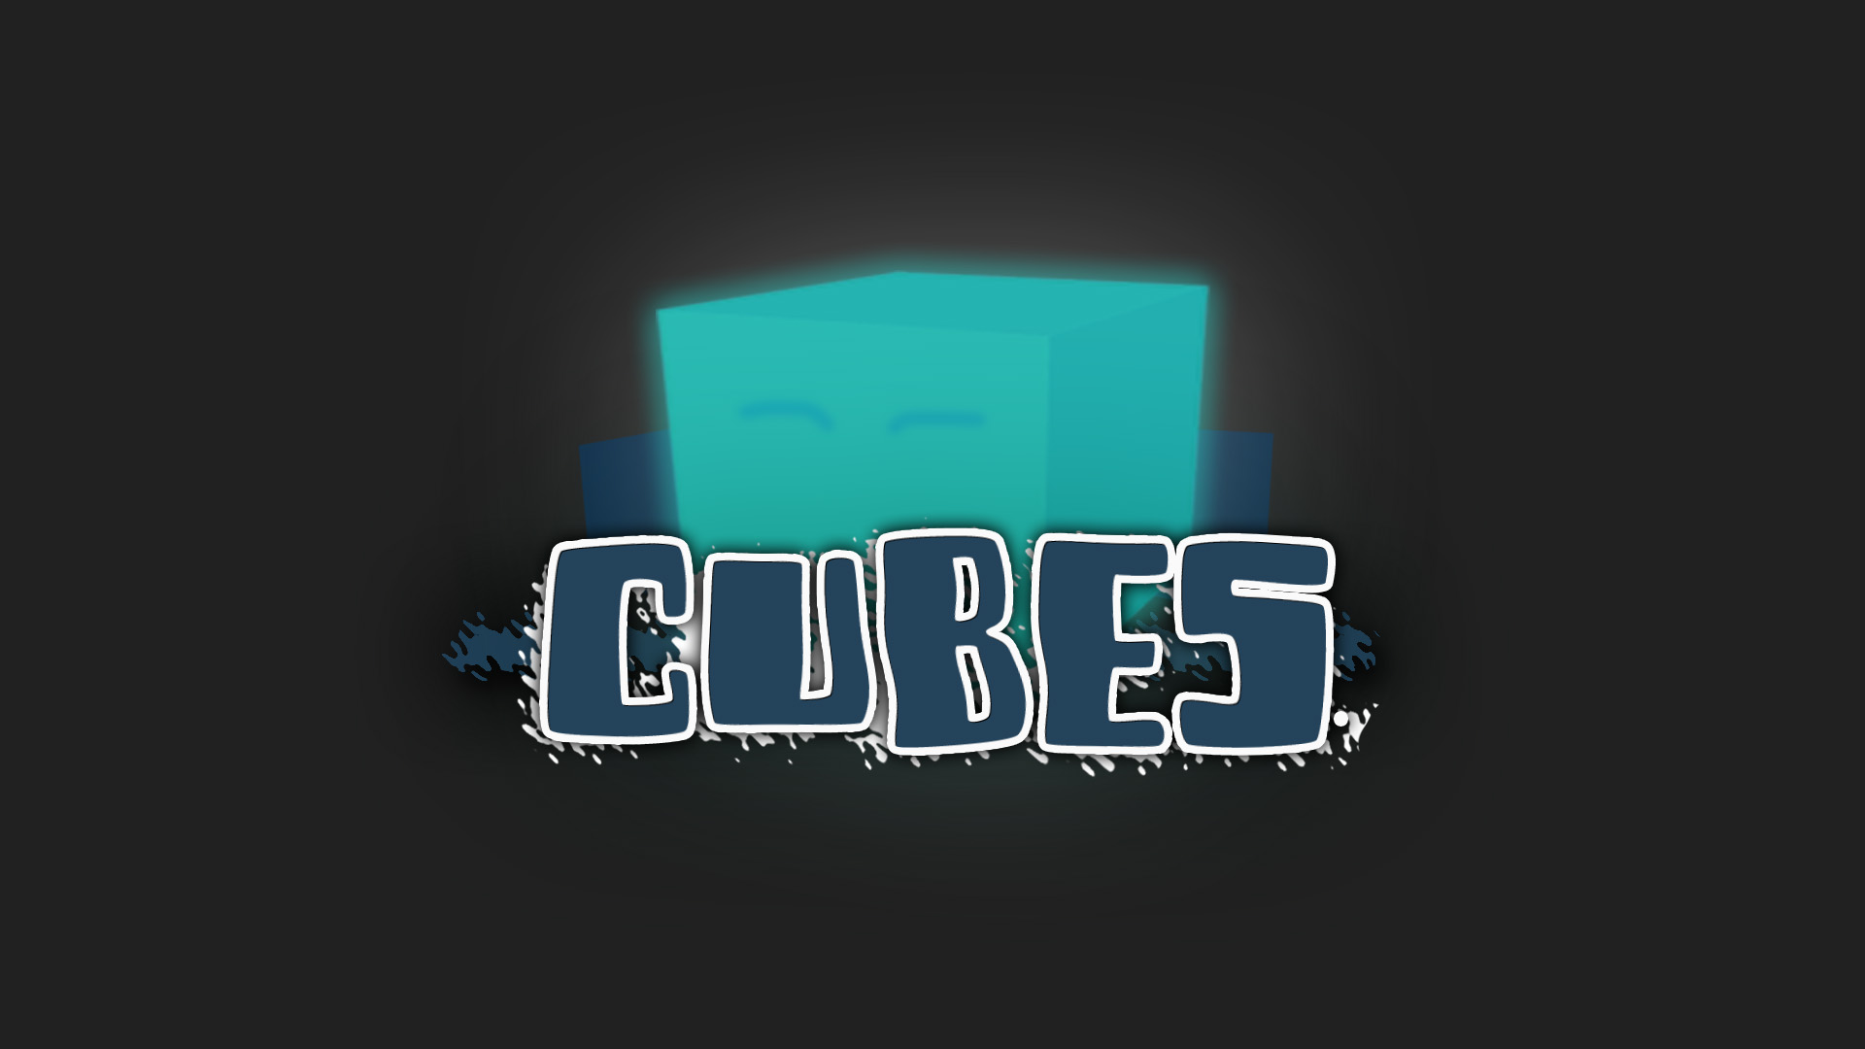

Slide 2
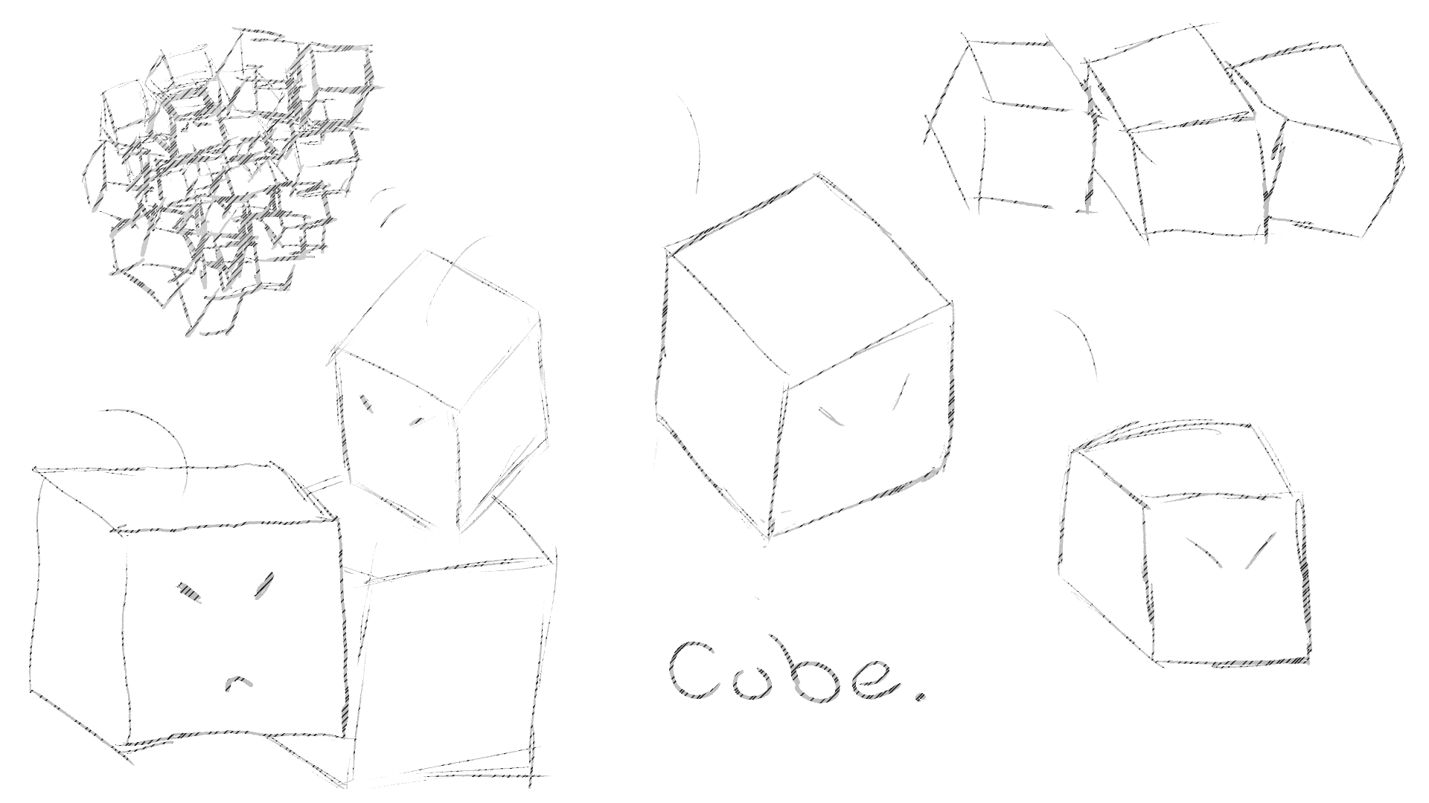
CONCEPT – GENERAL
SHORT DESCRIPTION
You are a lonely cube, trapped in a labyrinth and desperately looking for a way out.
GENRE
3D
Jump‘n‘Run
Single Platformer
NARRATIVE THEMES
Isolation
Desperation
Survival
LONG DESCRIPTION
SETTING
Cube is desperate. After some time of unconsciousness, he finds himself in an empty, dark room. He seems to be the only one who has reawakened and is now looking for a way out. Along the way, he realizes that he has gained a unique ability.
Cold
Sci-Fi
bright
CHARACTER
Thinker
Performer
Caregiver

Slide 3
STORY – WHAT...?
On his way, he encounters other cubes. However... he seems to be the only one who is conscious. Others have even lost their light. For Cubes, light means as much as life. This sight hurts him and he wonders if he is the only survivor.
Cube awakens in a dark room within a labyrinth. He is lonely and alone, imprisoned in the tower and without any memories, he tries to regain them and find more survivors.
He desperately searches for a way out of the tower. Struggling for his life, he masters the various hurdles and tries to restore the light of all cubes.
INJUSTICE
ISOLATION
DESPERATION
FREEDOM
SURVIVAL
FAMILY
LIBERATION

Slide 4
STORY – HOW...?
HOW DID THE EXPLOSION OCCUR?
Some time before, there was a big explosion – triggered by red cubes. Red cubes are evil cubes that only enjoy destroying and the spread of hatred.
HOW DID EVERYONE GET INTO THE TOWER?
To protect the threat of the evil Cubes, they tried to save themselves in a tower... Unfortunately, the protection it offered was not strong enough, causing most of them to lose consciousness or even their light.
WIE ERLANGT ER DIE FÄHIGKEIT?
Charged by the energy released by the explosion, the cube acquires a new skill.

Slide 5
STORY – WHY...?
WHY WAS THERE AN EXPLOSION?
WHY IS ONLY HE CONSCIOUS?
Red cubes wanted the whole world for themselves. That's why they triggered an explosion to completely wipe out the blue and yellow cubes.
The protagonist hid on the lowest level, in the darkest corner. The only room that could provide some protection against the explosion. He himself was unconscious for some time, but he (fortunately) "only" received radiation.
WHY DOES HE WANT TO REACH HIS GOAL?
To survive and to regain his memory
WHY DOES HE HAVE THE ABILITY?
WHY DOES HE HAVE NO MEMORIES?
Cube has acquired the ability to restore lights through light radiation. His body has received so much light that it has developed a defense mechanism, which now allows it to absorb and desorb the light itself. However, he has also lost his memories as a result.
WHY ARE THERE BLUE, RED AND YELLOW CUBES?
The colors are a kind of character trait. Yellow cubes are not completely good, but also not evil and are tolerated by the blue ones. Red cubes are evil and blue cubes are good.

Slide 6
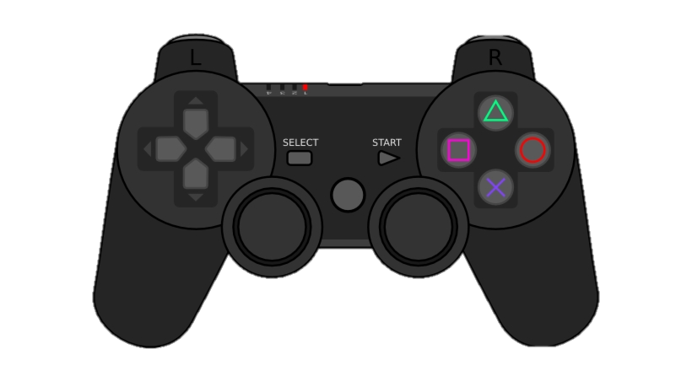
GAMEPLAY – GENERAL
Means if there is enough time
Movement
Interactions
With Cubes With buttons
Perhaps
Quest System
Wall Jump
Jump
Movement
Move,
jump
MECHANICS
Space
W
E
A
S
Interact
D
COLLECTABLES
Mini light Cubes
Heal
WORLD
LOOP & GOAL
Interact
Tower (Labyrinth)
The tower has many rooms. It goes steadily upwards with many different obstacles. The rooms are all of different sizes.
Goal
Revive as many cubes as possible Get outside / to the top
Gameloop
overcoming obstacles, keep coming to the top
Jump
Movement

Slide 7
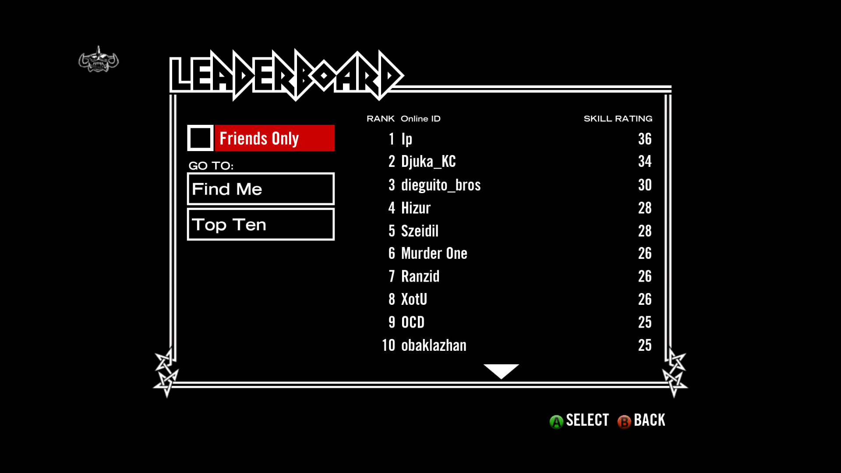
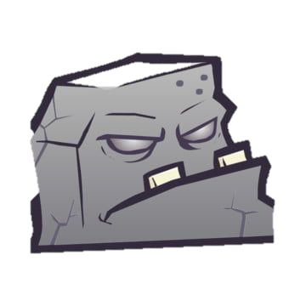
LOGO & GUI
UI
Scoreboard for collected lights
Logo Ideas
Preliminary thumbnail
Thumbnail
Title screen relatively simple
UI – Allgemein
The UI will be in a flat style.

Slide 8
SOUND & MUSIC
Goal
Sound Effects
Music
EARLY
The goal is to show the player how the cube feels right now and what the current mood is like
Movement
UI
Dreamy, Mysterious, Ambient
Jump Pad
Interaction
Collect
etc
MIDDLE
Action, Electro, Cyberpunk
GENRES
Action, Electro, Cyberpunk
END
Hopeful
Referenz
NAME OF SOUNDTRACK
Game: ???
Komponist: ???

